Slide 1

BRICS 2016
Labour and Employment Ministerial
Quality Employment, Employability and Decent Work: Policy objectives and required actions
Guy Ryder, Director General
International Labour Organization
25 January 2016

Slide 2
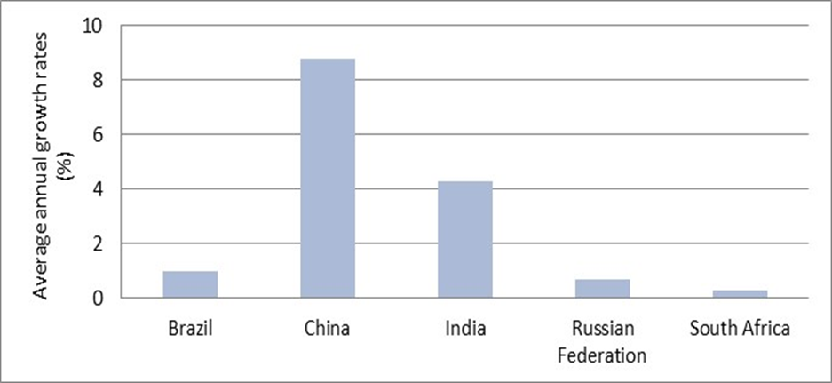
GDP per capita - average annual growth rates 1980-2013 (%)
Note: The average annual growth rate of Russian Federation is calculated between 1989 and 2013.
Source: ILO calculations based on World Bank, World Development Indicators.

Slide 3
Growth is not the whole story: high growth does not guarantee social inclusion
The Russia Federation, China and Brazil have made significant progress in reducing working poverty despite low growth rates.
In terms of reducing working poverty, India and South Africa made less progress.
The share of working poor in total employment continues to be high in India and still relatively high in China and South Africa.

Slide 4
High growth does not guarantee inclusion
Source: ILO, GET Model

Slide 5
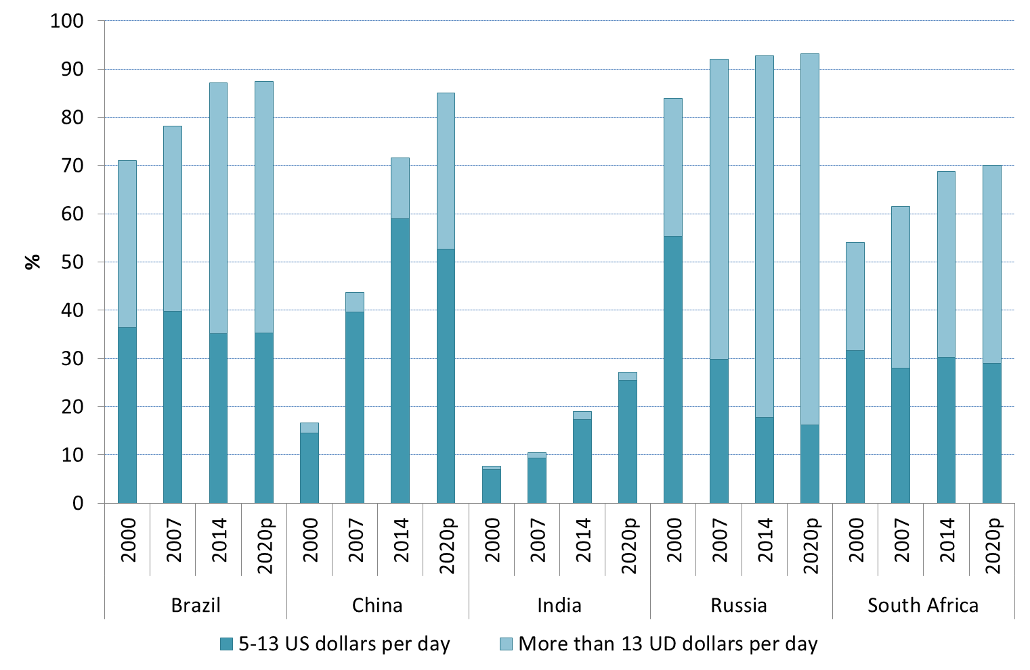
Growth and composition of the middle class
in BRICS countries, 2000-2020 (projected)
Note: Economic classes are defined by per capita per day consumption levels in US$, 2011 PPP.
Source: ILO estimates (October 2015 update); ILO, World Employment and Social Outlook: Trends, January 2016

Slide 6
Good news in the growth of the middle class
BRICS have been the drivers of the growing ‘global middle class’ in recent years and that is projected to increase from 1.8 billion in 2009 to 3.2 billion by 2020.
This has been in part a reflection of high GDP growth but the middle class is also a key factor driving growth through consumption.
The middle class can also be a force for political stability and democracy through its values of work, taxes, saving and investment.
And it demands development of education, health care, public services and social protection, which themselves help drive development.

Slide 7
Ensuring middle class growth continues
At the same time the middle class in the BRICS is vulnerable to falling back into poverty, informal employment. In many cases they are just above the moderate poverty line.
The share of the middle class remains low in some BRICS (China and India)
Essential to address inequality through balanced and redistributive growth
Need to increase the share of labour and household income in GDP
Extend access to quality education
Ensure quality of public services
Improve social protection systems

Slide 8
Gaps in capital formation remain large
Gross fixed capital formation per worker in the
non-agricultural sector (000s of USD at constant prices/exchange rates)
In per capita terms, BRICS still have only a fraction of capital compared with high-income OECD
This partly reflects low public capital stocks and physical infrastructure deficits

Slide 9
Despite slowing growth, it is essential to consider the employment implications of austerity
Expected rise in unemployment levels in emerging economies (baseline vs. spending cuts by commodity exporters, millions of people)
Fiscal balances of some exporters are being challenged by falling/low commodity prices
Ill-conceived expenditure cuts could worsen the employment outlook

Slide 10
Illustrative figures (not fully comparable)
on SMEs as providers of employment
Note: Should only be used as approximation, data are not directly comparable as some data sets do not include micro enterprises, non employer firms, or informal enterprises
Source: ILO calculations based on different sources

Slide 11
Smaller Firms tend to lag in productivity growth: annual labor productivity growth (%) by firm size
Note: Annualized growth in labor productivity as sales divided by full-time permanent workers. Annual labor productivity growth is the change in labor productivity reported in a fiscal year from a previous period. All values for sales are converted to USD using exchange rate in corresponding fiscal year of the survey. Sales are then deflated to 2009 using the USD deflator.
Source: World Bank Group Enterprise Survey Data. Data years: Brazil 2009, Russian Federation 2012, India 2014, China 2012, South Africa 2007

Slide 12
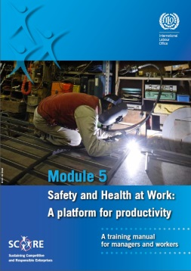

ILO SCORE Program
Advanced manufacturing practices
High-performance HR practices
Worker safety
Higher productivity and better working conditions in SMEs

Slide 13
SCORE Training Outreach: 750 SMEs = 200,000 workers
China
Manufacturing
Vietnam
Furniture manufacturing
Colombia
Manufacturing
Indonesia
Manufacturing
Peru
Manufacturing
Agroprocessing
India
Manufacturing
South Africa
Tourism
Ghana
Manufacturing

Slide 14
Improving the quality of technical and vocational education and training (TVET)
Enhancing the labour market relevance of skills development
Anticipation of future skills needs to improve the relevance of training
Promotion of workplace learning to facilitate school-to-work transition of youth
Social dialogue and involvement of the private sector in designing and delivering training programmes
Sustainable financing mechanisms for TVET
Equal opportunities to access quality education, vocational training and workplace learning

Slide 15
Public employment services (PES) play vital roles in reducing mismatch in labour supply and demand, including where labour migration within or across countries is involved
Public employment services (PES) can be important actors in connecting firms with trainers.
They can also improve job matching in cases of domestic labour migration and improve labour intermediation, including through activities such as pre-departure support and skills recognition.
Good practice in labour mobility programmes can also succeed across borders with coordination among PESs.
Russia has provided a good example of inter-regional online job matching and India also has inter-state coordination mechanisms.

Slide 16
Adequate social protection is a prerequisite for quality employment and decent work
Basic income security is a human need and adequate social protection for all is one of the explicit targets of the SDGs.
But it is also economically important, to support structural transformation of the economy by allowing workers to move to higher productivity sectors, locations and occupations.
It also stabilizes aggregate demand during economic downturns and acts as an automatic countercyclical policy.
Notes:
Adequate social protection is a prerequisite for quality and inclusive employment and decent work. It is not a coincidence that all of the BRICS countries have made enormous efforts to strengthen their social protection systems, to support their efforts to achieve sustainable and inclusive growth. We know from the experience of many countries at different levels of development how social protection systems contribute to growth and employment.
1. Social protection contributes to inclusive and sustainable economic growth by raising labour productivity and empowering people to find decent jobs.
Productive employment critially depends on effective social protection systems in place that can effectively ensure that workers have access to social protection in case of maternity, sickness, unemployment, employment injury, disability and old age; that workers can access health care services when needed, and that child benefits are available to support families and allow for the next generation of workers to achieve their full potential.
2. Social protection supports the structural transformation of the economy by providing income security for displaced workers and their families, and enabling them to find new employment, particularly if well-coordinated with active labour market policies.
The rapidly changing nature of the economy and labour markets requires effective adjustment mechanisms that avoid that structural transformations of the economy harm workers and their families and undermine social cohesion and social justice. Social protection, particularly unemployment protection, ensures that workers can count on an income while searching for a new job. Unemployment benefits or public employment programmes, especially if combined with skills development, job matching and career advice are important instruments to effectively support structural transformations of the economy.
3. Well-designed social protection systems enable countries to unlock their full productive potential and to promote inclusive growth.
In addition to the points already mentioned, social protection plays a key role in containing inequality and ensuring a fair distribution of the fruits of economic growth.
4. Social protection helps to stabilize aggregate demand during economic downturns and exercises a counter-cyclical function.
The global crisis has reminded us that social protection plays an important role in boosting and stabilizing aggregate demand, ensuring social peace and contributing to a more stable business environment.

Slide 17
Few unemployed workers in BRICS countries have income security while they search for a job
Share of unemployed receiving
unemployment benefits (%)
Note: Years indicate latest data available.
Source: ILO World Social Protection Report 2014/15; ILO Social Security Inquiry database for Brazil, India, South Africa, the Statistical Yearbook for China and the Interstate statistical committee of the Commonwealth for the Russian Federation.
Notes:
All of the BRICS countries have made impressive progress in strengthening their social protection systems in recent years. In fact, many other countries look at the BRICS countries as models, or have even applied some of the recent innovations developed in BRICS countries in their own countries. Just to mention a few, Brazil’s Bolsa Familia programme, India’s Mahatma Gandhi National Rural Employment Guarantee Scheme, China’s efforts in rapidly extending health protection coverage, and South Africa’s cash transfer programmes for children, older persons and persons with disabilities are widely discussed as prime examples. Russia, for its part, has a comprehensive system providing protection across the life cycle, including a well-established social protection floor.
Nonetheless, many challenges remain. Widespread unemployment and underemployment, as well as a large share of informal employment, continue to hamper economic and social development. One of the areas in which social protection can contribute to more productive employment is the area of unemployment protection. Unemployment benefits play a key role in ensuring income security for unemployed workers, and provide them with the possibility to search for a job that matches their skills and experience, rather than forcing them to accept any job. Thus, unemployment benefits play a key role in maintaining and upgrading human capital. Yet, only a small proportion of unemployed workers is actually receiving unemployment benefits.

Slide 18
Many older people in BRICS countries receive a pension, but benefit levels are often very low
Share of older persons receiving an old-age pension
Note: Years indicate latest data available.
Source: ILO World Social Protection Report 2014/15, Table B9.
Notes:
With regard to old age pensions, most of the BRICS countries have made great strides to achieve universal coverage. Such efforts are key in ensuring that those who have worked for their entire life, paid or unpaid, can enjoy at least a minimum level of income security during their old age.
While the extension of coverage has been very successful, a remaining challenge is to ensure the adequacy of old age pensions to allow older persons to share the fruits of economic progress. Financial sustainability remains an issue of concern, yet it should not be forgotten that the discussion about the sustainability of pension systems needs to look beyond financial sustainability – pension systems also need to be socially sustainable, that is, being perceived as fair and providing a meaningful protection to older persons, in order to be supported by a broad societal consensus.

Slide 19
Today’s working-age population has limited participation in pension schemes
Share of the working-age population
contributing to an old-age pension scheme
Note: Years indicate latest data available.
Source: World Social Protection Report 2014/15, updated based on labour force or household survey data for Brazil, India, and South Africa; Statistical Yearbook and estimates based on CHIP microdata for China; and administrative data from the ILO Social Security Inquiry and Interstate Committee of the Commonwealth of Independent States for the Russian Federation.
Notes:
Looking into the future, however, we realize that tomorrow’s challenges need to be addressed today. From what we know, less than half of today’s working age population in BRICS countries contributes to a public old-age pension scheme. That is, we can expect that the majority of tomorrow’s older persons will have to rely on tax-financed pensions and other social protection benefits, which constitute an important social protection floor, yet often provide only modest benefit levels.
Ensuring the adequacy of future pensions will not only require greater efforts in ensuring universal coverage and adequate benefit levels of future pensions (non-contributory and contributory pensions combined), but also greater efforts in increasing formal employment for both men and women.

Slide 20
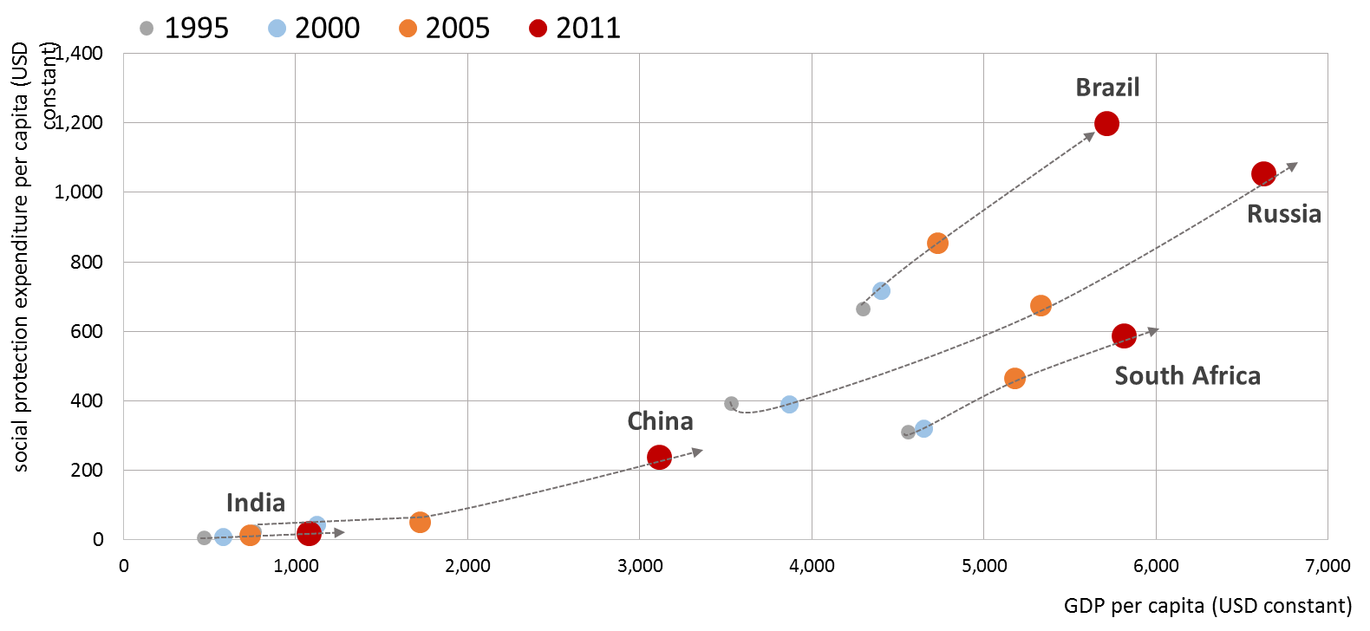
GDP per capita and public social protection expenditure per capita
(USD constant; 1995, 2000, 2005, 2011)
Note: Brazil data 2010 instead of 2011
Source: ILO social protection data based on IMF Government finances statistics; CEPALStat and World Bank, World development indicators 2015.

Slide 21
Policy objectives
and required actions
Extend social protection coverage towards universal coverage and build nationally-defined social protection floors
Improve the adequacy of social protection benefits to provide meaningful protection for the population
Strengthen coordination between employment policies and social protection policies
Exchange good practices and experiences in designing social protection policies to foster transition from the informal to the formal economy
Notes:
1. Further progress regarding the extension of social protection coverage towards universal coverage and the building of nationally-defined social protection floors, as part of comprehensive social protection systems.
Social protection is a human right that everyone, everywhere, should enjoy. We must ensure that no one is left behind and design, improve and maintain social protection systems so that each member of society are provided with the best income and health protection possible.
As a priority, national social protection floor should be established, to ensure access to basic income security and essential health care to all persons in need; higher levels of protection should be provided to as many people as possible, as fast as possible.
2. Improve the adequacy of social protection benefits to ensure that they provide a meaningful protection for the population.
Persistent levels of poverty, social exclusion and avoidable disease burdens show that social security benefits often do not live up to the challenge of ensuring a life in dignity for all. Social protection benefits should be at a level that at least ensure that people of all ages are able to purchase or access essential goods and services, enabling them to live healthily and decently. This means that their income should be lifted above the poverty level or a minimum level of income and they should be able to effectively access a set of essential health-care goods and services to be defined through a transparent national process.
3. Strengthen coordination between employment policies and social protection policies
It is indispensable to create positive synergies for sustainable growth and higher levels of decent employment between social protection, financial and economic policies.
Policy coordination and complementarity is key to achieving desired outcomes – and beyond:
Integrated national policies promoting productive employment are necessary to ensure sustainable financing, addressing possible skills shortages, promoting productivity, taking advantage of a wider diversity of the workforce in terms of sex, age, nationality and ethnic origin and facilitating a better balance between work and family responsibilities for women and men.
4. Exchange good practices and experiences in designing social protection policies in a way that fosters the transition from the informal to the formal economy
There is a wealth of experience and innovation amongst BRICS countries in finding tailor-made solutions to overcome the challenges to effective social protection coverage posed by informality.
This experience must be shared so that other countries can be inspired and find their own solution, best tailored to their national context.
There are some excellent channels of collaboration already established – the South-South process for instance. These must be expanded and maintained.
The ILO is already working with BRICS countries on many of these issues and will continue to offer its full support to efforts to achieve these objectives

Slide 22
BRICS 2016
Labour and Employment Ministerial
Quality Employment, Employability and Decent Work: Policy objectives and required actions
Guy Ryder, Director General
International Labour Organization
25 January 2016

