Slide 1

BRICS 2016
Formalization of the labour market: Quality and Availability of Jobs
Sandra Polaski
International Labour Organization
BRICS Labour and Employment Ministerial 25-26 January 2016

Slide 2
Topics for Session 2 discussion
Integration of macroeconomic and other policies to promote job creation in the formal economy
Formalizing informal jobs and enterprises
Enterprise modernization and increased productivity to foster formal employment
Improving occupational safety and health
Enforcement and protection of workers’ rights

Slide 3
A1 Macroeconomic policy: Effects of fiscal consolidation on employment
Projected rise in unemployment levels in emerging economies, millions of people
(baseline vs. spending cuts by commodity exporters)
Fiscal balances of some BRICS affected by low commodity prices
Excessive expenditure cuts could worsen the employment outlook

Slide 4
A2 Gaps in capital formation remain large
Gross fixed capital formation per worker in the
non-agricultural sector
(000s of USD at constant prices/exchange rates)
In per capita terms, BRICS still have only a fraction of invested capital compared with high-income OECD
This partly reflects low public capital stocks and physical infrastructure deficits

Slide 5
A3 Integration of macroeconomic, labour and social policies to promote job creation in the formal economy
Pro-employment macroeconomic policies
  Counter-cyclical policy to avoid increase in unemployment
  Use available fiscal space to increase well-targeted investment in infrastructure, public goods
  Consider providing incentives for other productive investments
Social protection schemes act as automatic stabilizers and are associated with higher productivity
Labour market policies to augment aggregate demand and enhance productivity

Slide 6
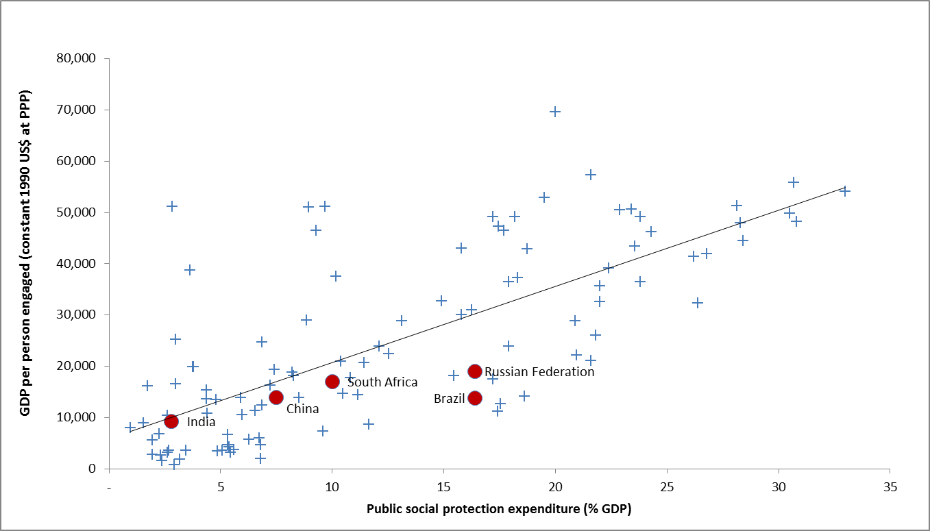
A4 Investments in social protection
are associated with higher labour productivity
Public social expenditure (% GDP) and GDP per worker (constant 1990 US$ PPP), latest year
Note: Latest data available (2010-2013)
Source: Social protection expenditure: ILO World Social Protection Report 2014/15, updated based on national information; labour productivity: ILO KILM based on Conference Board estimates.
Notes:
Moving to higher levels of labour productivity requires investments in social protection. Such investments in national social protection systems ensure that workers have access to health care, maternity protection and income security in case of employment injury, disability, unemployment and in old age. What is more, social protection also contributes to ensuring that children are not deprived of their live chances, have access to quality health care, education and child care, and can realize their full potential.
For information: correlation coefficient r2=0.5417

Slide 7
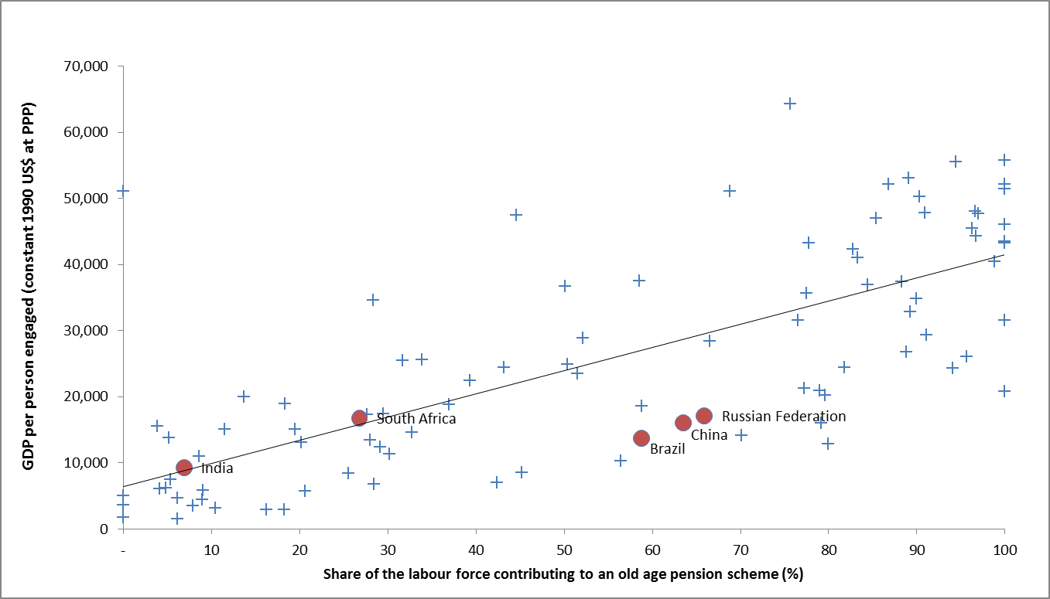
A5 Higher levels of employment offering social protection associated with higher labour productivity
Share of the labour force contributing to an old age pension scheme (%) and
GDP per worker (constant 1990 US$ PPP), latest year
Note: Latest data available (2008-2014)
Source: Social protection coverage: ILO World Social Protection Report 2014/15, updated based on national information; labour productivity: ILO KILM based on Conference Board estimates.
Notes:
Labour productivity is closely associated higher levels of formal employment, and workers enjoying comprehensive social protection coverage (using as a proxy the share of the labour force contributing to an old age pension scheme). Informality traps workers in low productivity activities and economic insecurity. The recent efforts of BRICS countries in extending social security coverage horizontally and vertically, by building national social protection floors and strengthening their social protection systems, goes into the right direction. More efforts are however needed to ensure sustained progress in promoting decent and productive employment, and more inclusive and sustainable growth.
For information: correlation coefficient r2=0.5426

Slide 8
A6 Economic growth in the BRICS has translated into higher wages and stronger aggregate demand
Real average wage index, 2007/08 - 2014
Note:Data for India are only available once every two years. For this reason, data points appear every other year with the exception of 2007 and 2008. Real wage growth between 2007 and 2008 (17%) actually refers to the real wage growth between 2005-06 and 2007-08.
**Due to a break in the series, the 2014 estimate in South Africa refers to year-on-year growth for the last three quarters of 2013 to 2014.
Source:ILO Global Wage Database (www.ilo.org/ilostat)

Slide 9
A7 One effective policy tool to reduce inequality has been the minimum wage
Ratio of the minimum to median wage
Notes: Data refer to 2011 in India, 2010/11 in South Africa, 2009 in China and 2012 in Brazil and the Russian Federation. In Brazil and the Russian Federation, the national minimum wage is used. In China, the minimum wage in Beijing is used. In South Africa and India, the minimum wage is a weighted average of the minimum wages in effect. Minimum wages were weighted by the number of employees who earned a particular minimum wage.
Source:: ILO estimates based on national statistical sources

Slide 10
B1 Fostering transition to formality of informal jobs and enterprises
ILO Recommendation 204: a guiding framework to achieve three interrelated objectives
Promote the creation and sustainability of enterprises and decent jobs in the formal economy
Facilitate the transition of workers and economic units from the informal to the formal economy
Prevent the informalization of formal economy jobs

Slide 11
B2 Informal employment in the BRICS
% of non-agricultural employment, latest year available

Slide 12
B3 Facilitating the transition of firms to the formal economy
Effective provision of information
Assistance in complying with relevant laws and regulations
Consider well-targeted financial support (loan guarantees, discounted tax rates during limited transition period, etc.)
Preventive and appropriate corrective measures
Effective sanctions to address tax evasion and avoidance of social contributions, labour laws and regulations

Slide 13
B4 Facilitating the transition of workers to the formal economy
Progressively extend protection to workers in the informal economy:
      social security (pensions, unemployment benefits, health care)
      coverage of minimum wage laws
      improved working conditions
      maternity protection
Targetted active labour market policies and training programs to enable workers to compete for formal jobs

Slide 14
C1 Enterprise modernization and productivity
ILO Approach: Improve both management practices and working conditions to increase productivity
Inputs
modern management practices
and
improved working conditions
Final Impact
More and better jobs
Additional income for both firms and workers
Intermediate Outcomes
SME Productivity improved

Slide 15
C2 Does it work? Lessons from large firms
Better Work Vietnam
  Investments in good working conditions are not just a “cost”
Improved working conditions associated with 6-8% higher profits
Dialogue matters for firm improvement
Profitability effect strongest when improvements in working conditions include dialogue with workers
  Profitability effect driven by higher productivity
Higher performing firms provide higher wages but enjoy similar supply chain position as their lower performing competitors
Source: Better Work survey data collected from 2010-2013 in 185 factories enrolled in Better Work Vietnam. Over 5,000 worker responses and 500 manager responses collected.

Slide 16
C3 Some results from research and
ILO SCORE Program
Investments in occupational safety and health improve SME productivity
Packages that integrate working conditions into core operations of businesses more successful
40-50% of SMEs in SCORE program report cost savings in first three months
SCORE participants report 16% decrease in accidents and more business from international buyers
Sources:
Croucher et al. (2013), Can Better Working Conditions Improve the Performance of SMEs?
Data from SCORE Monitoring System

Slide 17
D1 Improving occupational safety and health: an urgent challenge for the BRICS

Slide 18
D2 BRICS’ Work-Related Deaths Caused by Disease
Total BRICS Work-Related Deaths
1.04 Million
845,000

Slide 19
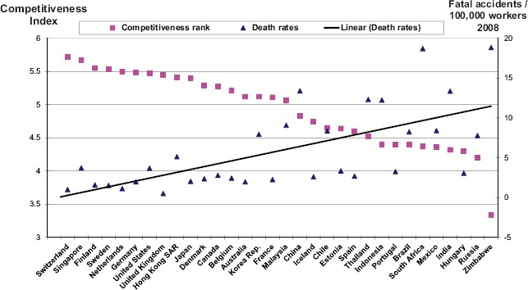
D3 Inverse Correlation of Competitiveness
and Occupational Safety and Health
Note:
Source:
(Source: WSH Institute and World Economic Forum, 2012–2013)

Slide 20
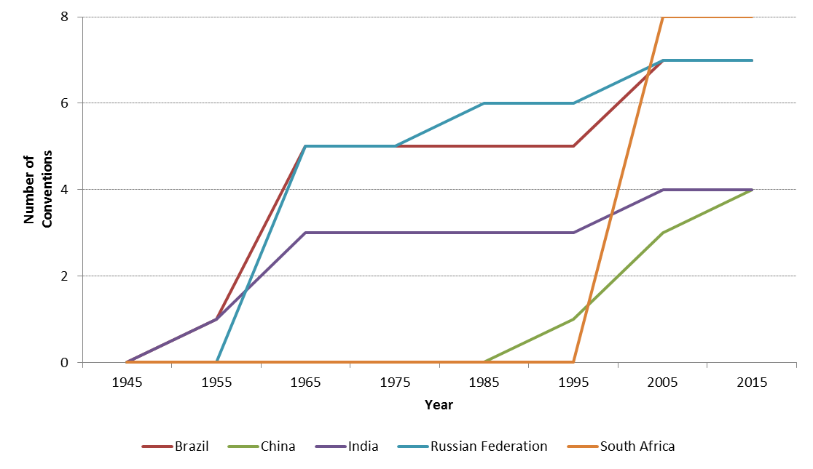
E1 Ratification of International Labour Standards in the BRICS countries
Ratifications of the Fundamental Conventions, by year
(Accumulated number)

Slide 21
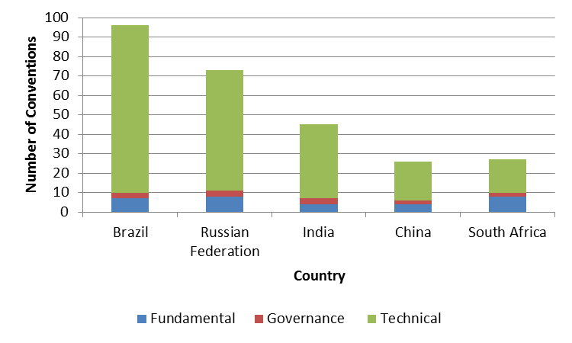
E2 Overall ratification of ILO conventions
in BRICS countries
Number of Conventions ratified by BRICS countries
Source:: NORMLEX

Slide 22
E3 Fundamental Principles and Rights
at Work in the BRICS
Child labour: overall trends show decline. Comprehensive laws and policies in place on CL, with some important laws still pending approval.
Forced labour: rising concerns with human trafficking. New legislative measures introduced on FL, sometimes with a special focus on human trafficking or “slave labour”.
Discrimination: gender pay gap higher than global average of 23%. New laws against workplace discrimination but limited enforcement in practice.
Notes:
Child labour: Data available on India and Brazil, see next slides. South Africa has very little incidence of child labour: China fragmented information available, indicating the relevance of the phenomenon; no information available on Russia.
Forced labour: no national estimates available as yet but qualitative information indicates incidence of forced labour and human trafficking in all BRICS
Discrimination: no national estimates available as yet. Gender Pay Gap is the key indicator of pay discrimination faced by working women. It is more than the global average of 23% in each of the BRICS. There are no data from reliable sources quantifying the discrimination that other groups, such as LGBT people, migrants, HIV positive people, etc. face in the world of work. Migrant workers as well as black, indigenous and mixed-race workers continue to receive lower wages than white workers, with black, indigenous and mixed-race women being the most affected by the wage gap.
FACB: trade union density and collective bargaining coverage are used as proxy indicators

Slide 23
Collective bargaining coverage rate in the BRICS
Trends in collective bargaining coverage rate
Note:With the exception of China, rates are defined as the percentage of employees covered by collective (wage) bargaining as a proportion of all employees, adjusted for the possibility that some workers do not have the right to bargain collectively over wages. In China, the rate represents workers covered by collective contracts. The law mandates that the official union represent workers' interests in a process of collective consultation with employers over wages and other conditions of work. The legal provisions for collective consultation do not provide for workers or employers to carry out protected industrial action.
Source: : ILO STAT (www.ilo.org/ilostat)

Slide 24
Summary
  Overall, the years of high growth in the BRICS produced some important improvements in each of the labour markets
  Good growth in wages
  Extensions of social protection coverage
  Strengthened laws on labour rights
  Moderate job growth
  Major challenges ahead
    Further increase in living standards, wages, social benefits
    Maintaining progress under lower growth, tight fiscal conditions
    Effective enforcement of laws protecting workers’ rights
    Tackling informality and bringing all workers under rights and benefits regimes

Slide 25
BRICS 2016
Thank you
Sandra Polaski
International Labour Organization
Meeting of the Ministers of Labour and Employment of BRICS countries
25-26 January 2016

